Slide 1
Effectively Deploying Chicago PD by Zip Code
CDT Cooper Klein, USMA ’24
CDT Sydney Watson, USMA ‘24

Slide 2

Background and Problem Statement
Chicago Police Department
Understaffed and cannot maintain presence in every zip code
Understanding spatial and temporal trends will allow for better deployment
Notes:
Other data complexity

Slide 3
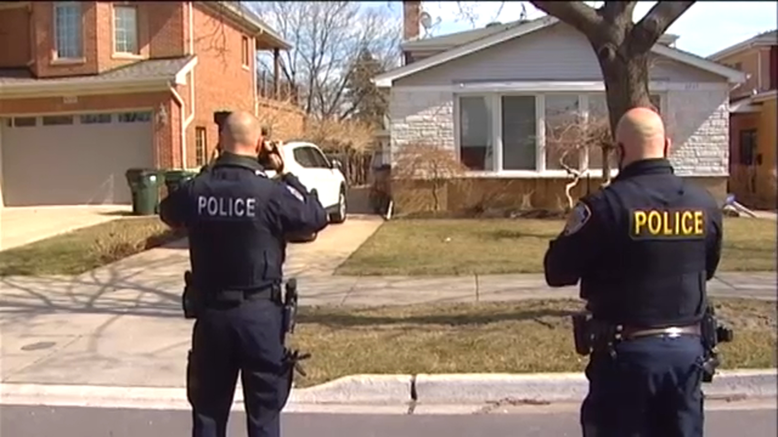
Research Questions
Are socioeconomic factors associated with the number of daily burglaries?
Is there an effect of zip code on daily burglaries that the other features do not account for?
Is there an impact of day of week on burglaries? Should additional officers be hired part time?
Notes:
Other data complexity

Slide 4
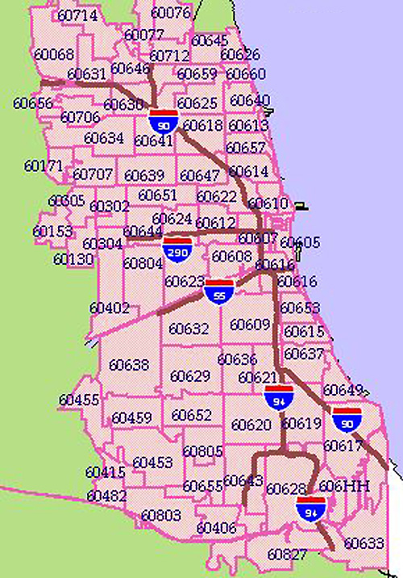
Data Availability
58 Zip Codes
Burglaries JAN2022-DEC2023
Total Population
Median Earnings
Day of the week
% of population with a degree above high school
Males per 100 females
Notes:
Other data complexity

Slide 5
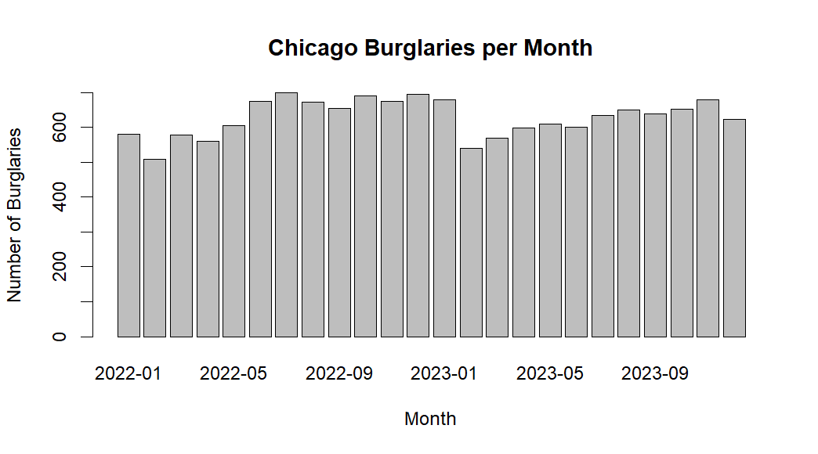
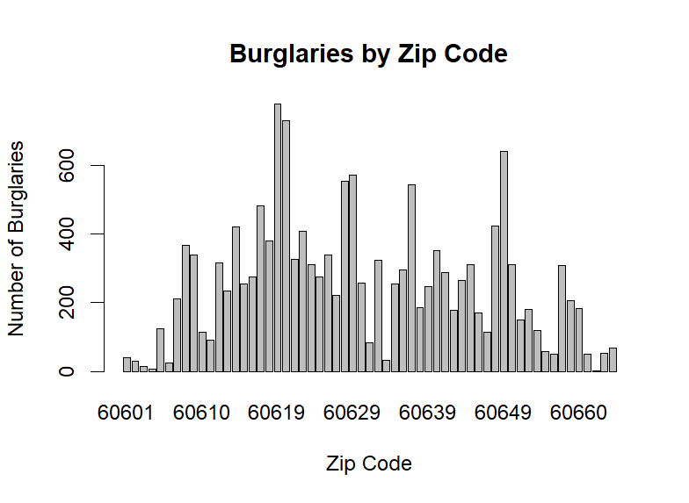
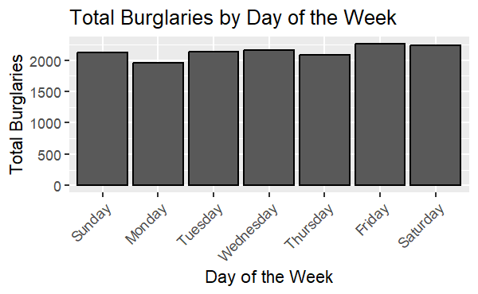
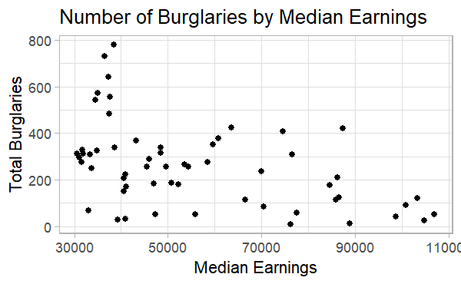
Data Exploration
Notes:
Other data complexity

Slide 6
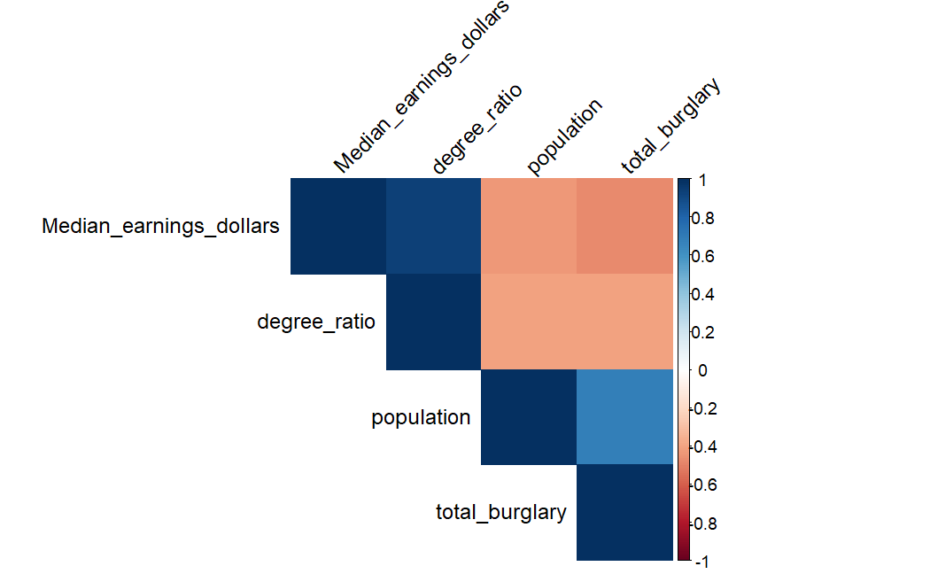
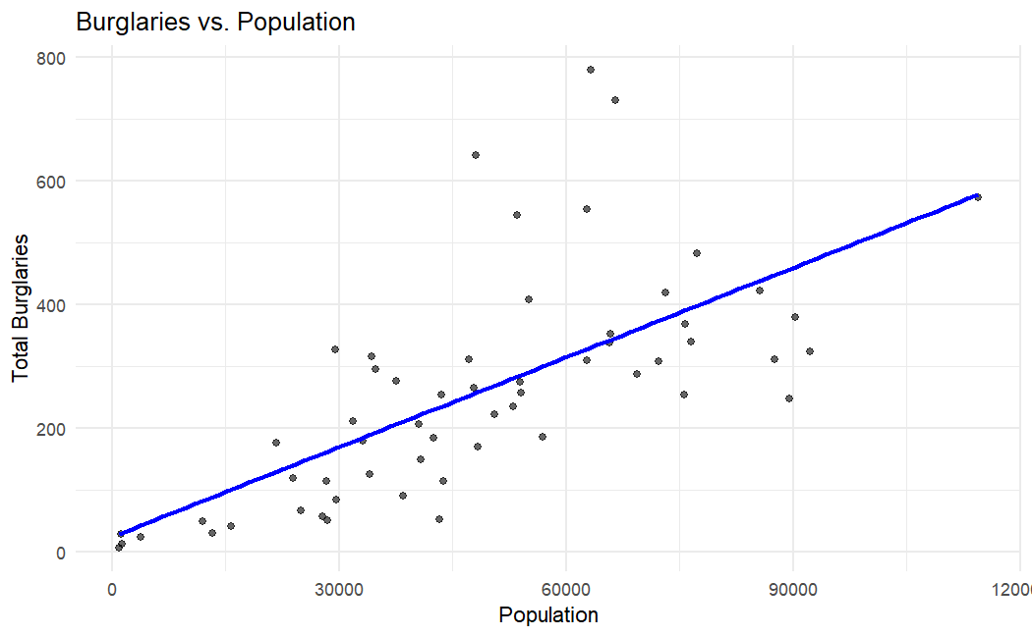
Data Exploration
Burglaries v. Population
Correlation Matrix of Features
ssddddddddd
Notes:
Other data complexity

Slide 7
Methodology Overview
Chicago crime data
Find burglaries, zip codes
Find Census data on zip codes
Aggregate over day of week
Proposed Models
Spatial model with Census covariates
Spatial model accounting for random effect of zip code
Spatial and temporal model with random effects of zip code and fixed effect of day
Notes:
Other data complexity

Slide 8
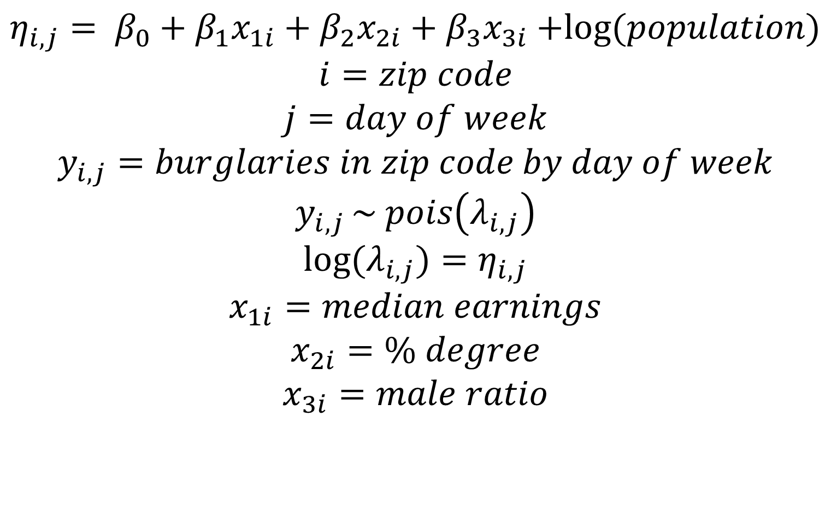
Model 1
Are socioeconomic factors associated with the number of burglaries?
$η_{i,j}= β_{0}+β_{1}x_{1i}$ $+{ β}_{2}x_{2i}$ $+{ β}_{3}x_{3i}$ $+log⁡(population)$
$$i=zip code$$
$$j=day of week$$
$$y_{i,j}=burglaries in zip code by day of week$$
$$y_{i,j }\sim pois\left(λ_{i,j}\right)$$
$$log⁡(λ_{i,j})=η_{i,j}$$
$$x_{1i}=median earnings$$
$$x_{2i}=\% degree$$
$$x_{3i}=male ratio$$
Notes:
Other data complexity

Slide 9
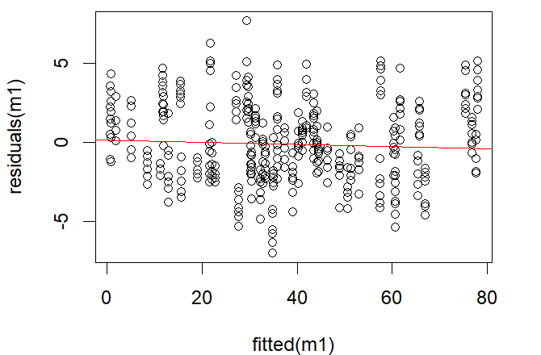
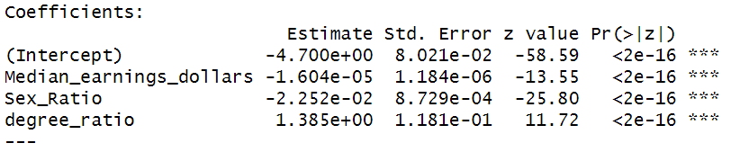
Model 1 - Results
Residuals v. Fitted Plot
 | Poisson | Negative Binomial
Dispersion Parameter | 6.346 | 5.655
Log Likelihood | -2304.64 | -1626.09
We prefer the Negative Binomial Model, but the Poisson is more interpretable.
Notes:
Other data complexity

Slide 10
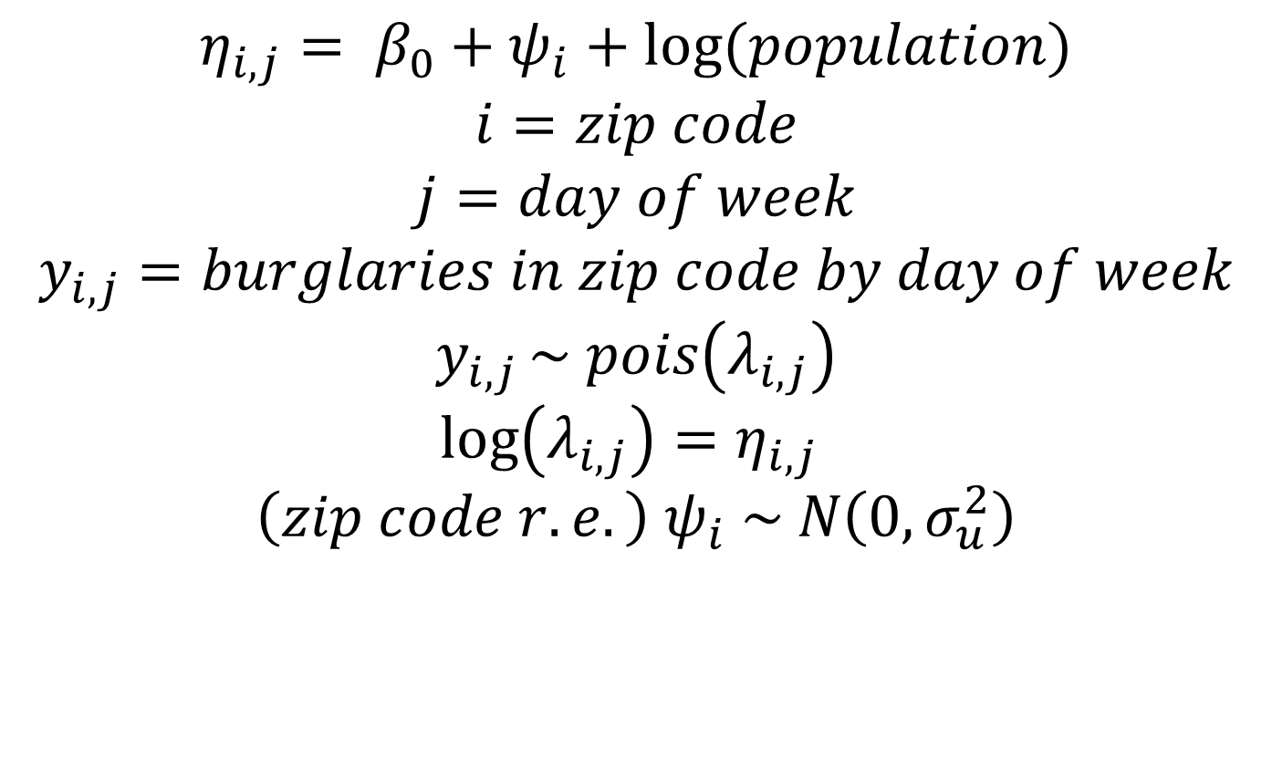
Model 2
Is there an effect of zip code on daily burglaries that the other features do not account for?
$$η_{i,j}= β_{0}+ψ_{i}+log⁡(population)$$
$$i=zip code$$
$$j=day of week$$
$$y_{i,j}=burglaries in zip code by day of week$$
$$y_{i,j }\sim pois\left(λ_{i,j}\right)$$
$$\log\left(λ_{i,j}\right)=η_{i,j}$$
$${\left(zip code r.e.\right) ψ}_{i} \sim N\left(0,σ_{u}^{2}\right)$$
Notes:
Other data complexity

Slide 11
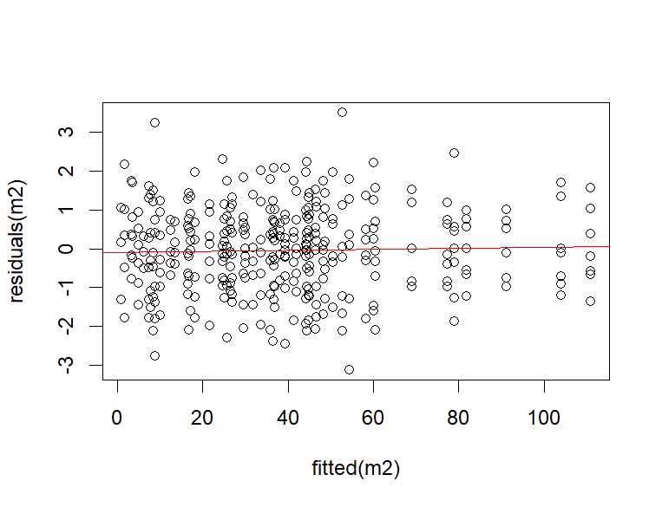
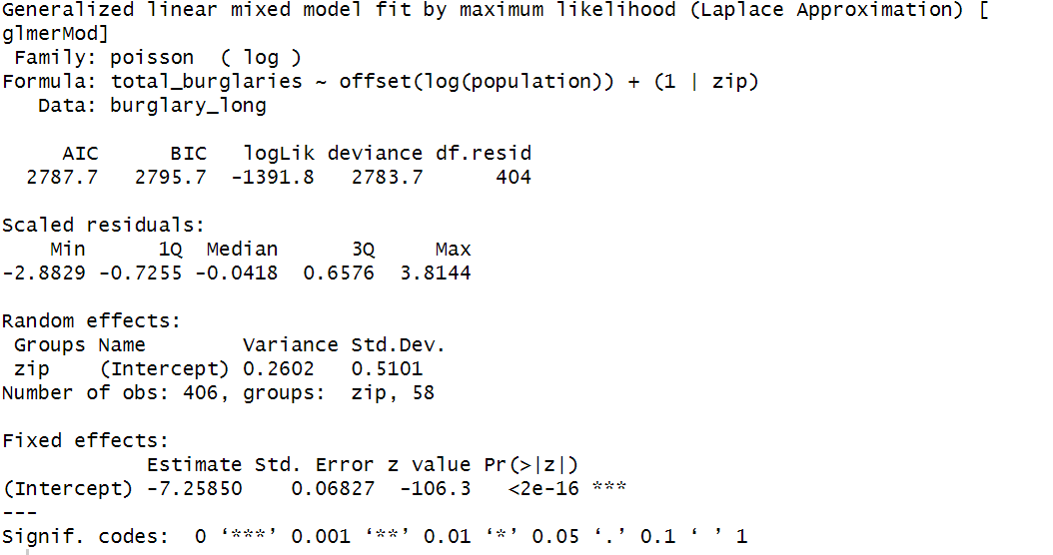
Results
Residuals v. Fitted Plot
 | Deviance
Null Model | 3560.3
Model 2 | 2783.7
AIC | 2787.7
There is an effect of zip code on burglaries not captured by previous factors
Notes:
AIC lower than Model 1

Slide 12
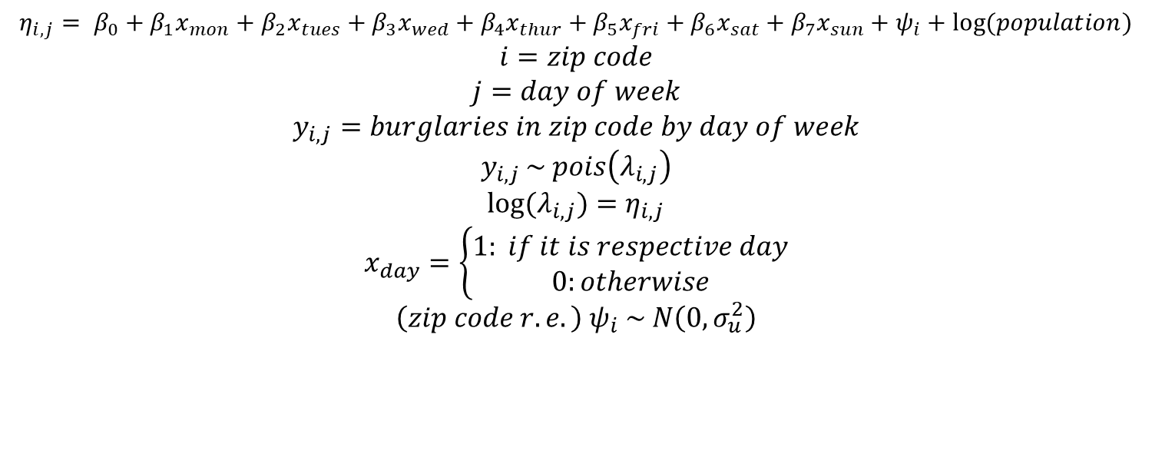
Model 3
Is there an impact of day of the week on burglaries? Should additional officers be hired part time?
$$η_{i,j}= β_{0}+β_{1}x_{mon}+β_{2}x_{tues}+β_{3}x_{wed}+β_{4}x_{thur}+β_{5}x_{fri}+β_{6}x_{sat}+β_{7}x_{sun}+ψ_{i}+log⁡(population)$$
$$i=zip code$$
$$j=day of week$$
$$y_{i,j}=burglaries in zip code by day of week$$
$$y_{i,j }\sim pois\left(λ_{i,j}\right)$$
$$log⁡(λ_{i,j})=η_{i,j}$$
$$x_{day}=\left\{\begin{aligned}1: if it is respective day \\ 0:otherwise\end{aligned}\right.$$
$${\left(zip code r.e.\right) ψ}_{i} \sim N\left(0,σ_{u}^{2}\right)$$
Notes:
Other data complexity

Slide 13
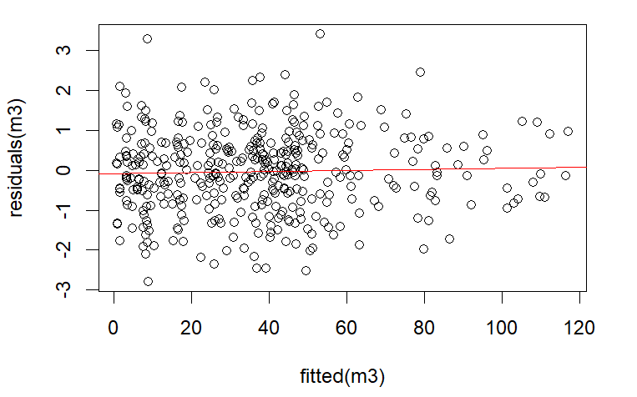
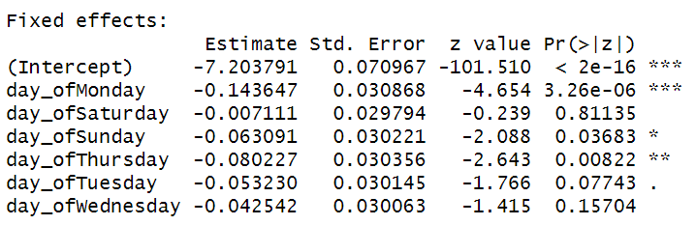
Results
Residuals v. Fitted Plot
Day of the week as a fixed effect does not add sufficient information.
Notes:
Other data complexity

Slide 14

Recommendations to CPD
Population Adjusted Patrol Scheduling
Distribute Resources based on Zip Code Variability
No need to fluctuate officer patrols per day
Invest in Further Research
Notes:
Other data complexity

Slide 15
Questions? Feedback?

